Slide 1
Roseville, Part 3
Augmented, 26/4/2021
John Colgan

Slide 2
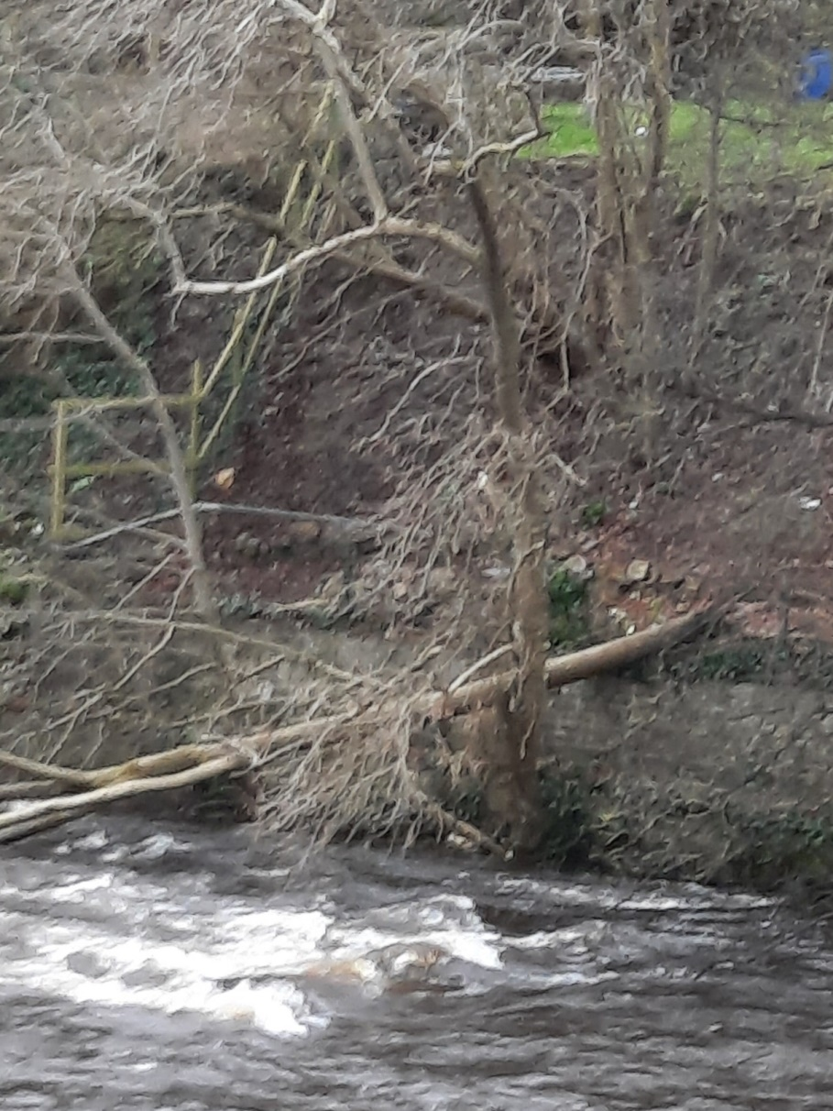
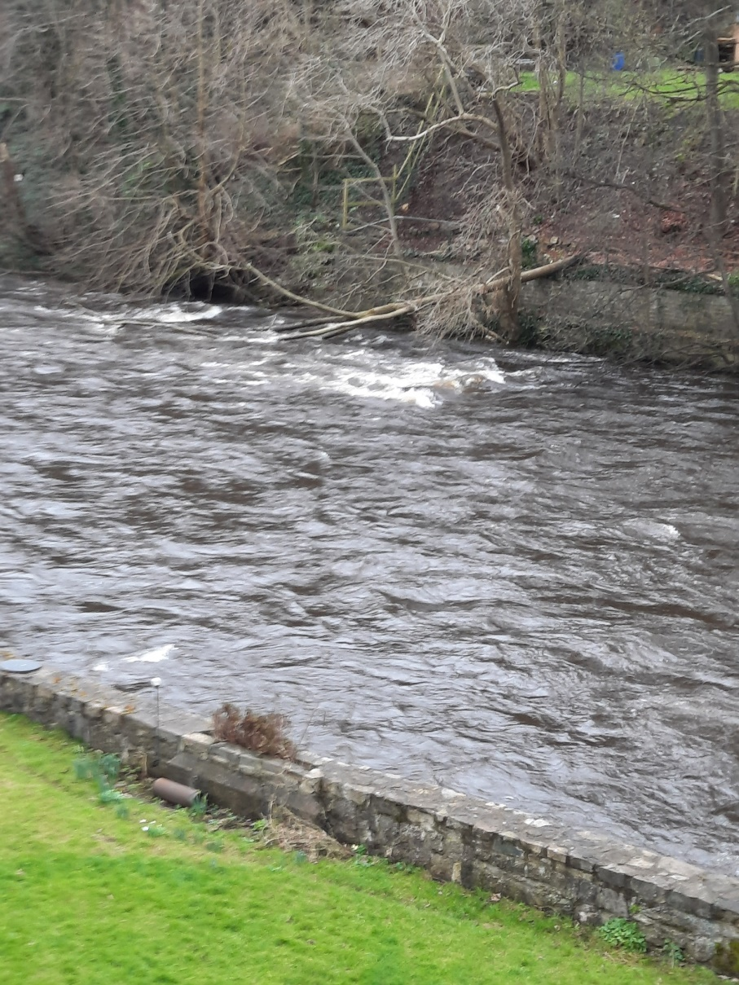
Fallen, or partly sawn tree, which fell after stormy night of 23/2/2021, when cover had been previously taken away by Roseville owner/occupiers. The bottom 2m was sawn off by men, 27/2/2021 and removed, with remainder left in the river. The butts of other sawn trees are seen beside this one.

Slide 3
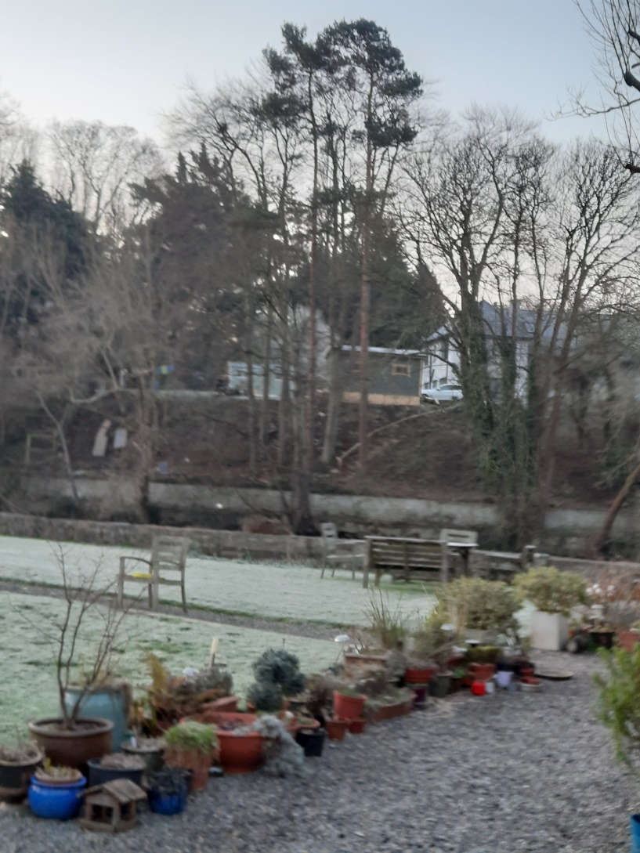
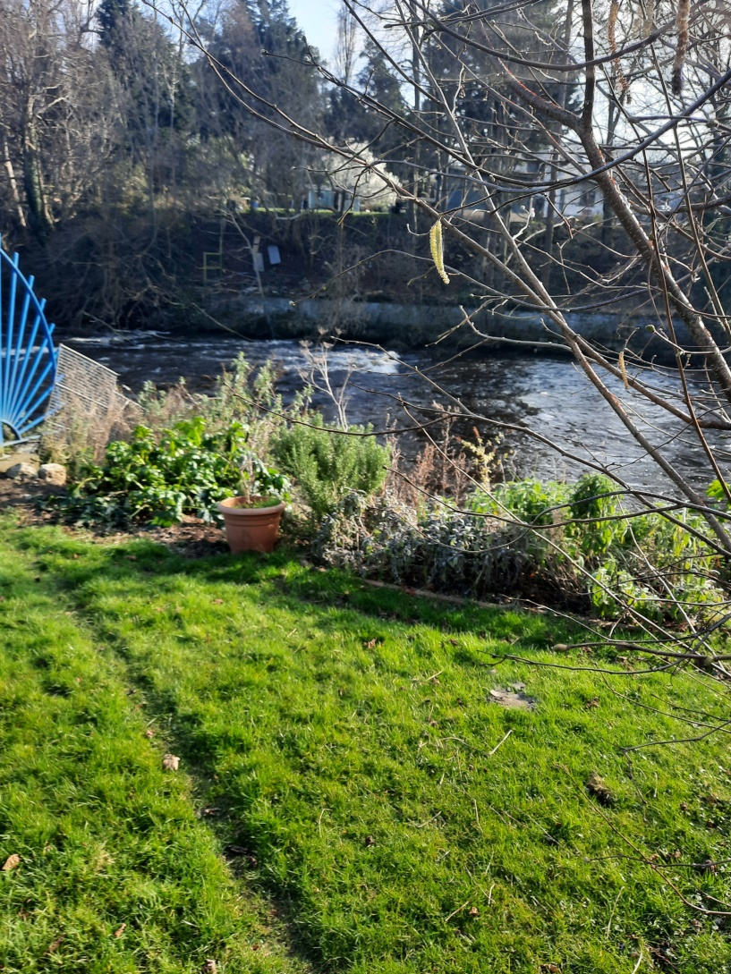
South bank 7/3/2021, left, from near Toll House door and from upper lawn, 4/3/2021 showing badger track.

Slide 4
Canoeing on the Liffey
The Council’s Development Plan for the Liffey Valley anticipates the use of the Valley for sporting events, the premier one of which is the annual Liffey Descent canoe race from Straffan, Co Kildare, to the Garda Rowing club, Islandbridge. Some 400 competitors from around the globe compete. They require security and rescue services near Leixlip Bridge, and access via adjoining land. Regular canoeing takes place, including instruction. Leixlip Bridge area is occasionally the scene of Sky and other TV sports coverage of these events from a helicopter overhead. The future may be clothes’ lines blowing in the wind, hitherto concealed by the wilderness.
Slalom events, involving the tieing of sisal across the river between trees and other convenient places has been greatly impaired by the gratuitous removal of trees from the south bank.

Slide 5
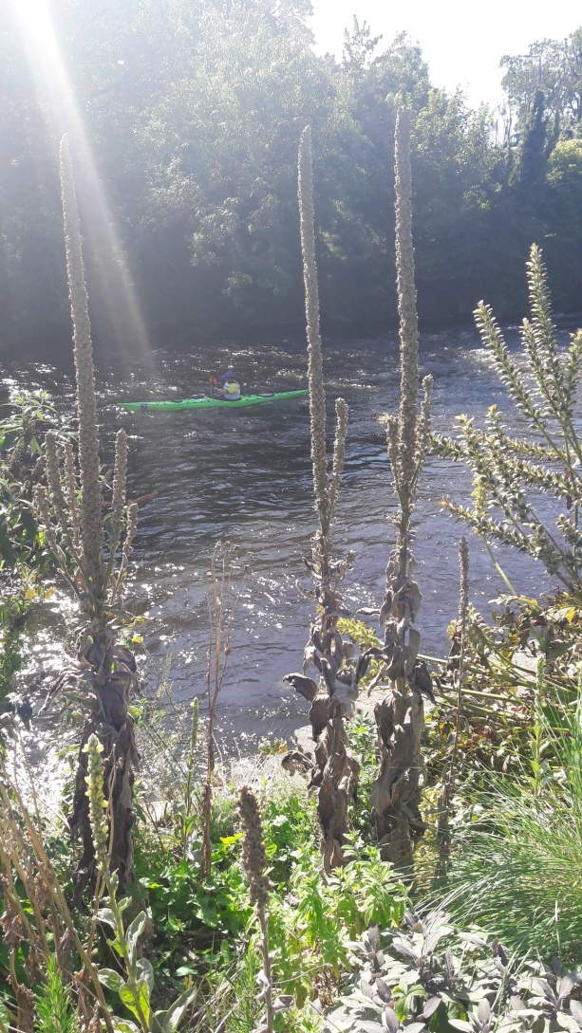
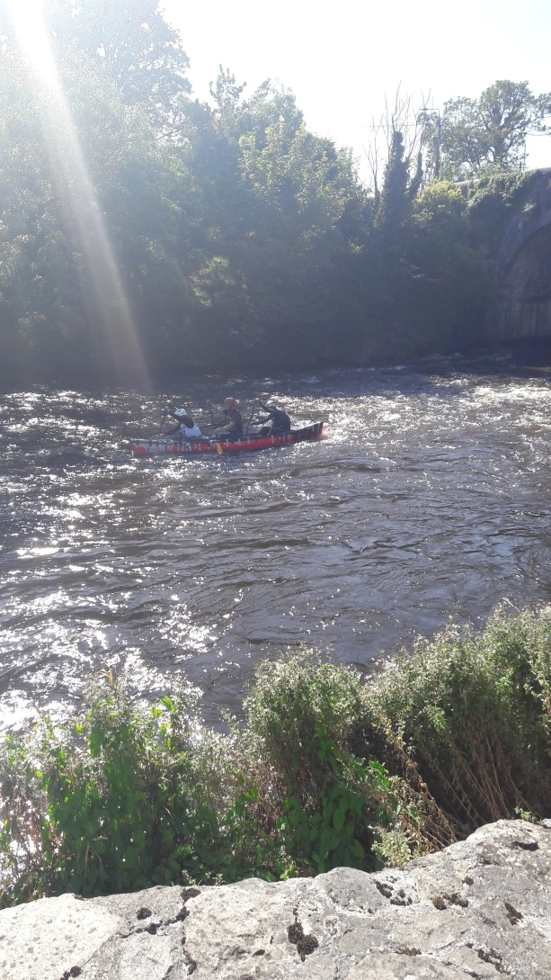
Every Sept or October, some 400 canoeists compete in the Liffey Descent race. On occasion, there have been Slalom events, which involve tying sisal string between anchors (trees, screws) on opposing banks. I’ve had to ask the Irish Canoe Union to untie them! These canoeists are from 14/9/2019.

Slide 6
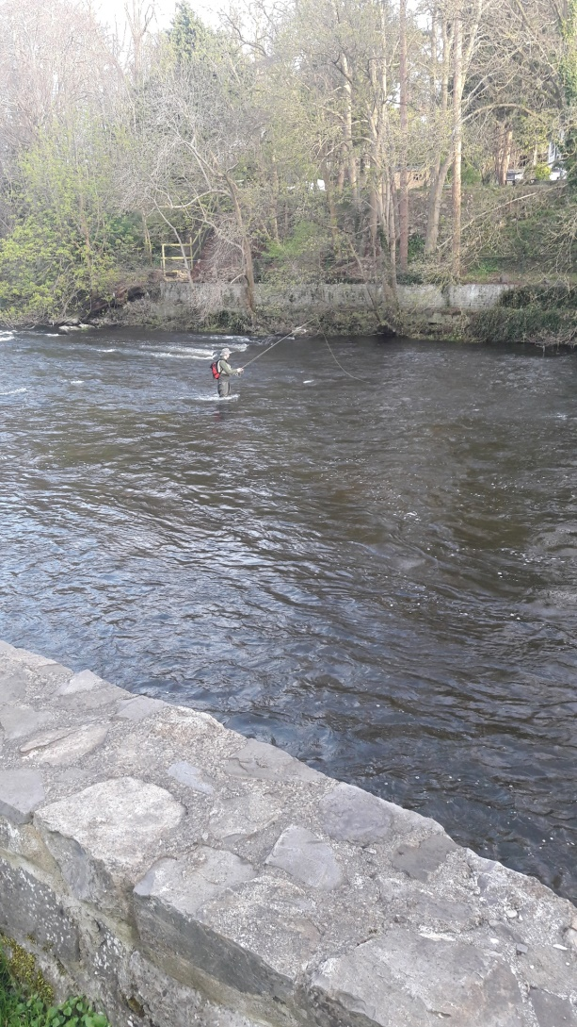
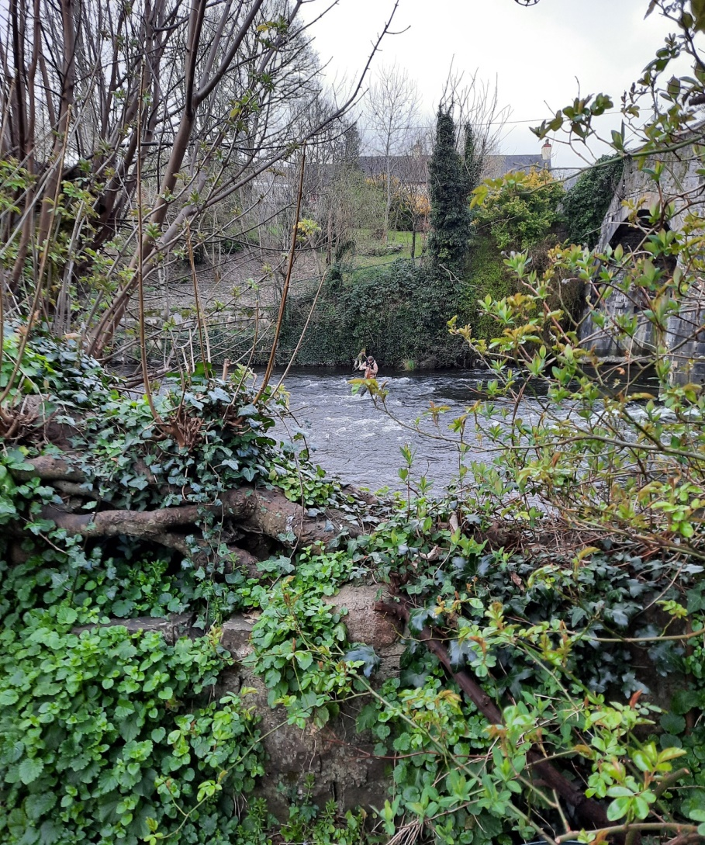
ANGLERS on the Liffey opposite Roseville and Toll House are regular events; here’s one last April (left) and one present this week (right). The removal of overhanging trees ruins the habitat of flies… The anglers gain access via Castle Park road, path and park network.

Slide 7
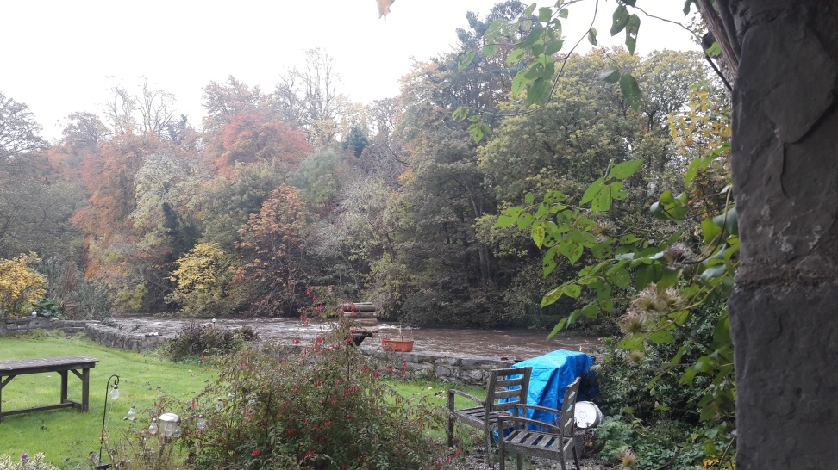
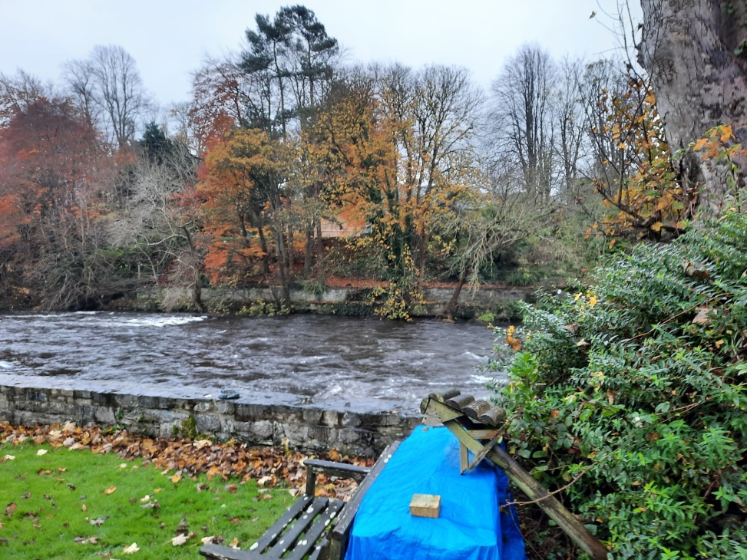
Illustrating the gradual destruction of the Liffey Valley’s wooded area, the preservation and extension of which is part of the development plan. No development within 30 metres of the Liffey’s edge
Photo taken 3/11/2019
Photo taken 15/11/2020 Section left of white water is neighbouring property

Slide 8
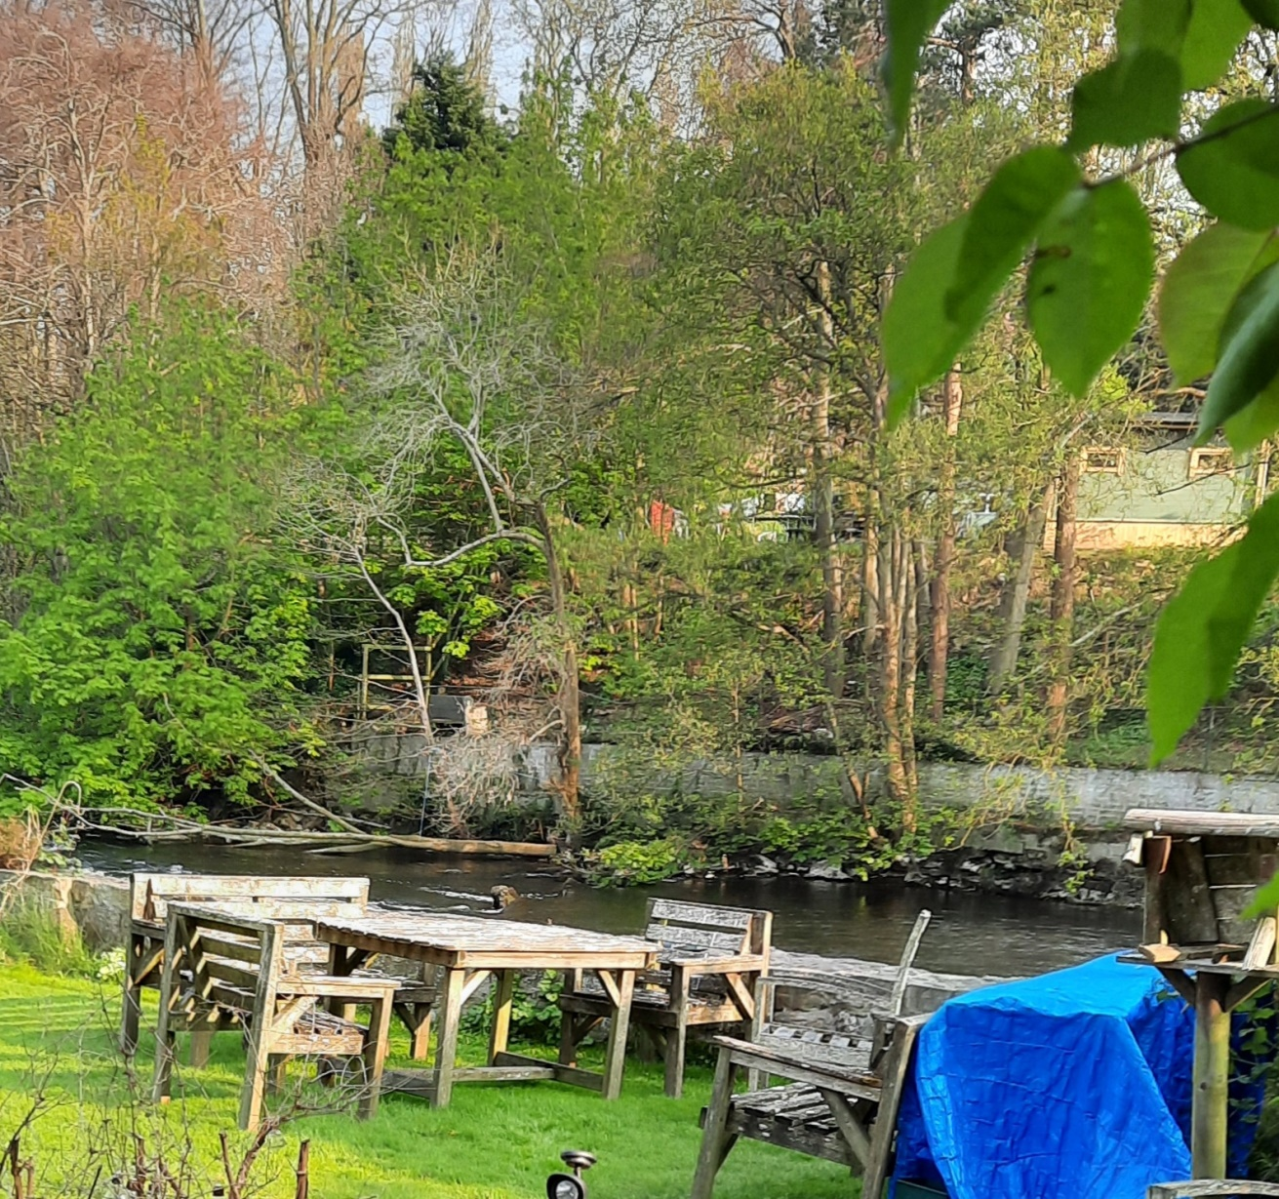
Photo taken, Wednesday, 21/4/2021. Greenery cover to left is neighbouring property on south bank of Liffey. Tree trunk in river is tree that fell. or fell after being partly cut, into the river on 23/2/2021, from the base of the escarpment, following removal of other tree cover on the embankment. Sheomera to rhs. Clothes lines on plateau area. Furniture added recently at lhs foot of escarpment.

Slide 9
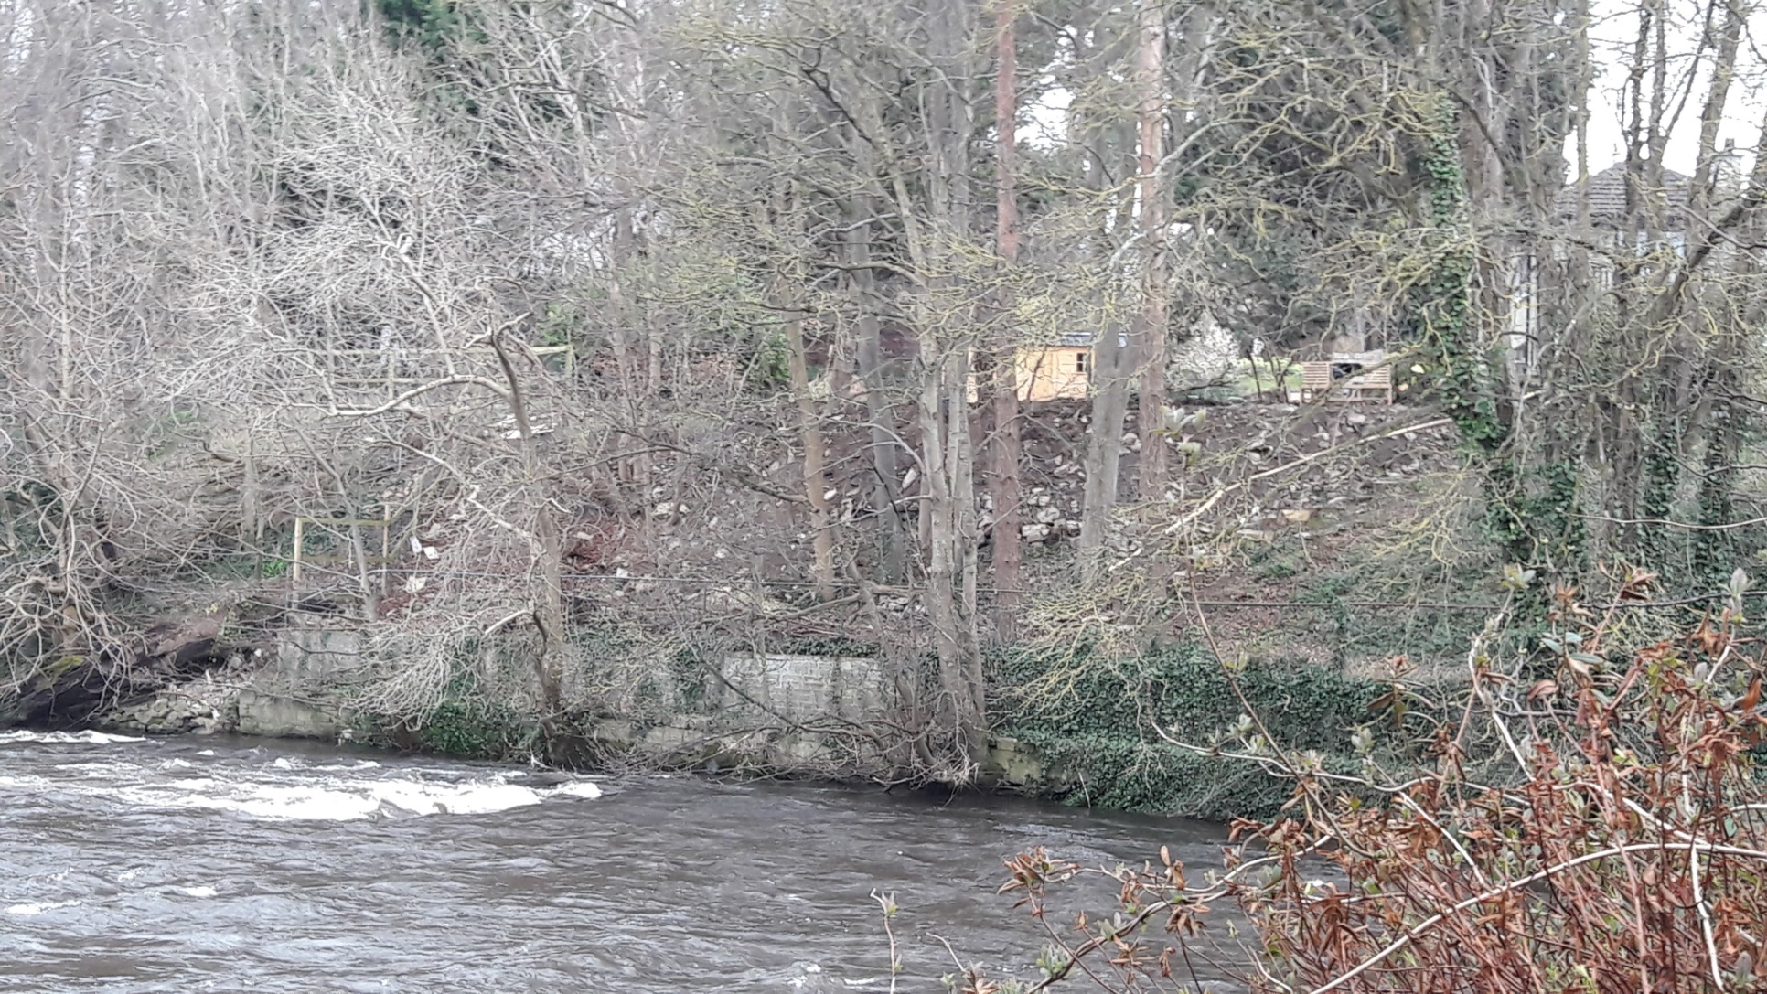
South bank by Roseville, photo taken 26/3/2018, showing stumps of trees after this phase of cutting the wooded escarpment back. Shomera building not yet in place.

Slide 10

Roseville, 15/11/2020

Slide 11
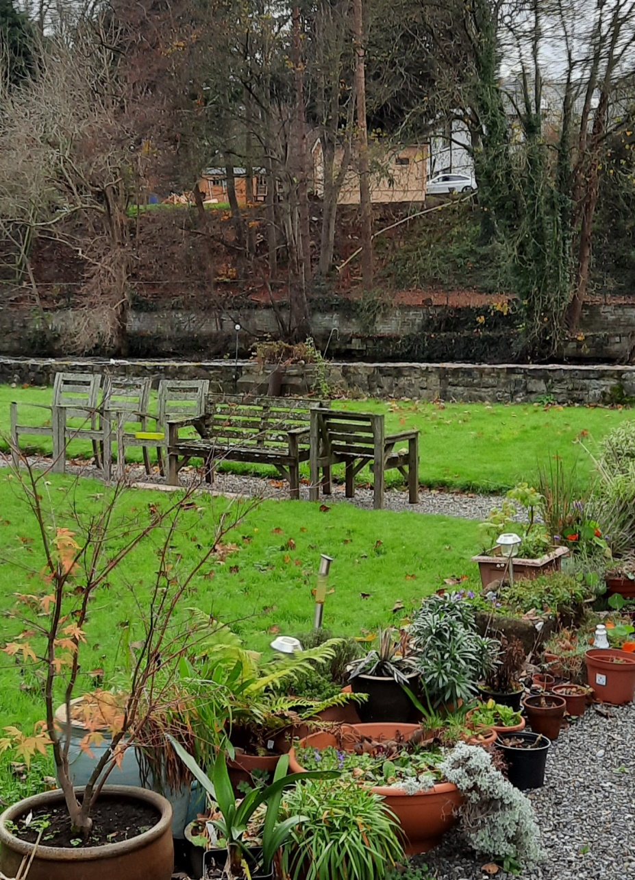
Shed and Shomera building, 25/11/2020

Slide 12
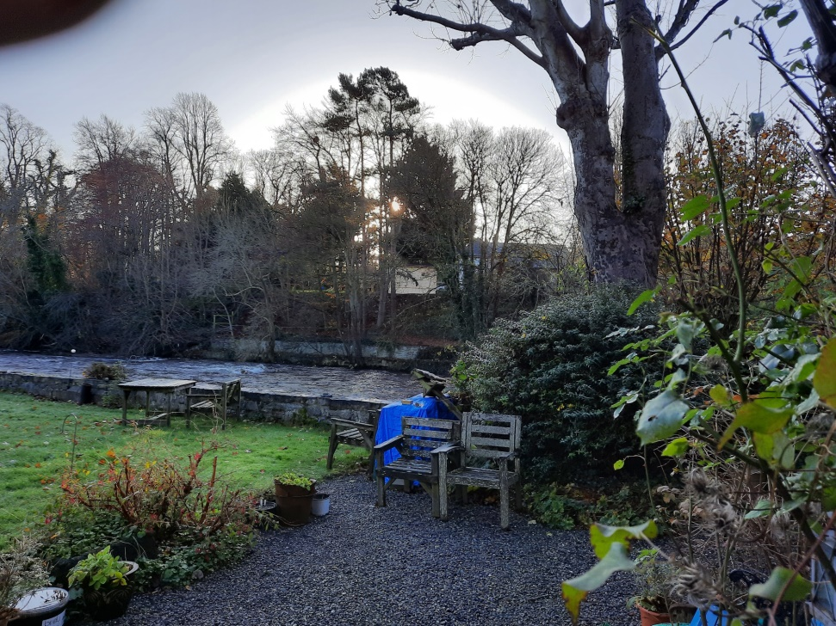
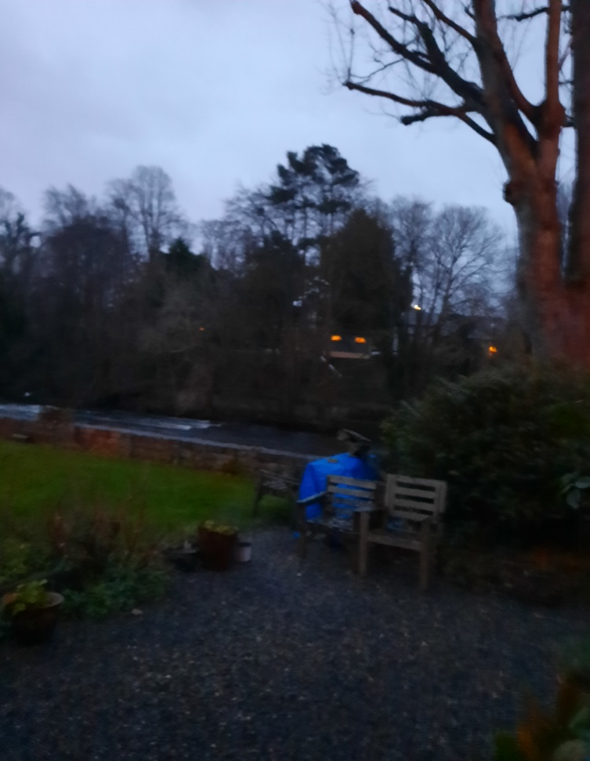
Shomera building, 25/11/2020 (Left) and lit up, 4.32pm, 26/12/2020

Slide 13
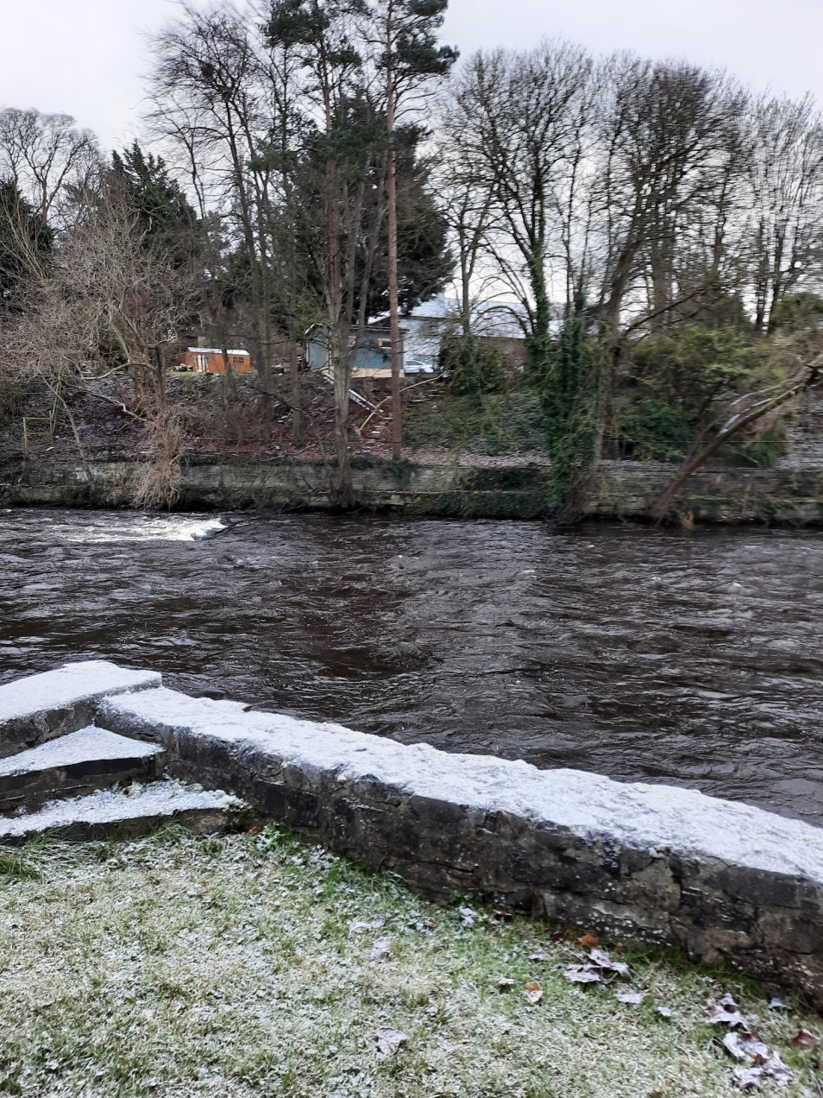
New timber Steps and rail for Roseville, 31/12/2020

Slide 14
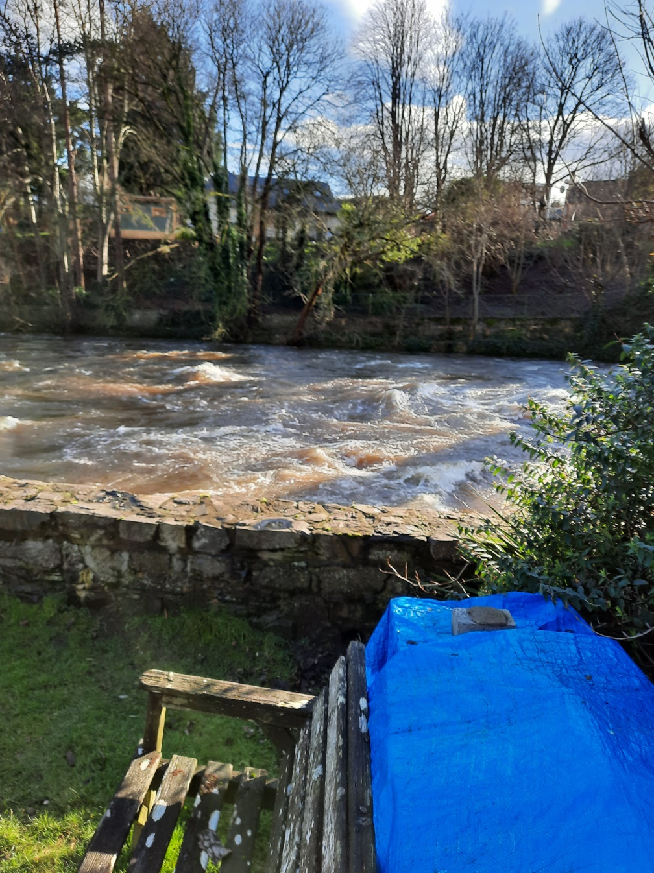
Photo, ~4/2/2021: Taken after lopping off the top grown and mulching it on site.

